Slide 1
Waves
Sounds have a vibrating source, a medium and a receiver.
The frequency of the sound is determined by the source.
The speed of the wave is determined by the medium.
The receiver interprets the sound.
Sound is a longitudinal wave where the energy is transmitted parallel to the motion of the particles. This is opposite to transverse waves like water where the particles vibrate perpendicular to the propagation of the wave.
http://paws.kettering.edu/~drussell/Demos/waves/wavemotion.html
Two particles are said to be in phase if their displacement is nx360 degrees apart. They are out of phase if nX180 degrees apart where n is an odd integer. 03A6
Waves interfere with each other constructively when in phase and destructively when out of phase. (refer diagram)WS52,
http://id.mind.net/~zona/mstm/physics/waves/interference/twoSource/TwoSourceInterference1.html

Slide 2
Interference patterns between two waves of equal amplitude travelling in opposite directions can produce a standing wave (musical instruments).WS54,
http://www.walter-fendt.de/ph14e/stwaverefl.htm
Two waves of slightly different frequencies sounding simultaneously will produce a third wave of a frequency equal to the difference between the frequencies of the two waves. (beats)
http://hyperphysics.phy-astr.gsu.edu/hbase/Sound/beat.html
Waves will spread out around solid objects or when passing through an opening. This is due to diffraction. The angle of diffraction increases as the ratio of wavelength to gap width increases.
http://www.acoustics.salford.ac.uk/feschools/waves/diffract3.htm
When an object is made to vibrate at its natural frequency by another vibrating object, it is said to be resonating.(WACE10q20) http://www.phys.unsw.edu.au/jw/flutes.v.clarinets.html
Pipes can be classified as open or closed and can resonate at multiple frequencies called harmonics. (03 A8)
http://dev.physicslab.org/Document.aspx?doctype=3&filename=WavesSound_ResonancePipes.xml

Slide 3
Waves travelling from one medium to another will refract.(WACE10A1)
http://micro.magnet.fsu.edu/primer/java/reflection/huygens/index.html
http://paws.kettering.edu/~drussell/Demos/refract/refract.html
11. Sound travels faster in warm air v = 331 + 0.6 T

Slide 4
The Doppler Effect
When the source of the sound or the receiver is moving, the wavelengths are shortened if moving towards each other or lengthened if moving away.
The waves are still travelling at the speed of sound which means the frequency of waves passing the observer is altered and we hear the sound at a different pitch.
http://galileoandeinstein.physics.virginia.edu/more_stuff/flashlets/doppler.htm

Slide 5
Questions:
Why does a note played on a flute sound different when played on a clarinet? (Must get 2/10)
http://hyperphysics.phy-astr.gsu.edu/HBASE/music/otone.html
http://paws.kettering.edu/~drussell/Demos/string/Fixed.html
Answer: Due to the method of sound production, the material from which the instruments are made and the relative strength of the harmonics present. (graph)

Slide 6
3. The 3rd harmonic of an open pipe resonates with the 5th harmonic of a closed pipe. What is the ratio of their lengths?(7/10)
Answer: Draw envelopes
l_{o} = 1.5wl l_{c} = 1.25wl
l_{o}/l_{c} = 1.5/1.25 = 6:5 or 1.2:1

Slide 7
A man is standing 10m from 2 speakers which are 6m apart equidistant from the two. The speakers are producing a note of 440Hz. He moves from the midpoint between the two speakers to stand directly in front of one speaker but still 10m from it. Draw on a graph of intensity vs his movement what he hears as he moves.(9.5/10)
Answer: Draw a diagram. Add dimensions.
Refer to two wave interference pattern.

Slide 8
Projectiles
There are 3 types of projectiles:
http://www.youtube.com/watch?v=ZsQSlNtzLcA
a. Angle of launch = 0º, S is down.
b. Angle of launch not 0º, S = 0m
c. Angle of launch not 0º, S is up or down.(WS 39)
2. Max. range for b is at 45º.
3. Path is parabolic when no air resistance.(03B5)
4. Air resistance acts directly against instantaneous velocity. (Tangential to curve)
5. Final velocity has vertical and horizontal components. Must express as magnitude and direction.
(WACE10Q17)
http://www.animations.physics.unsw.edu.au/jw/projectiles.htm#3

Slide 9
Questions:
How far from the base of a 50m cliff does a rock land if kicked parallel to the ground at 5.0m/s? (Must get 2/10)
Answer:
S = ut + 0.5at²
50 = 0 + 0.5x9.8xt²
t = 3.19sec
R = vt = 5x3.19= 15.97m
What if the question said how far(displacement)from the starting point?

Slide 10
A football is kicked from ground level at 20ms⁻¹ and at 40⁰. At what horizontal distance from the starting point is it 3.5 m above the ground? (6/10)(8/10)
Answer: unless 3.5m is the maximum height reached, there will be two answers to this question.
S = ut + 0.5at² (a is negative)
3.5 = 20sin40t - 4.9t²
t₁ = 0.3s t₂=2.3s
R₁ = 20cos40⁰ x 0.3 = 4.6m
R₂ = 20cos40⁰ x 2.3 = 35.2m

Slide 11
3. At what velocity must a 1.8m basketball player shoot if she is attempting to score from halfway (15m) and throws the ball at 40 degrees from horizontal (height of ring: 3.0m)(8/10)
Derived from the equations for motion:
S = RtanA - 4.9 R²
V₀²cos²A
^{Answer:} 12.84m/s

Slide 12
4. What launch angle produces the maximum range? Prove your answer. (9.5/10)
Answer: 45º
S = ut + 0.5at²
where S = 0, ut = 4.9t² or u = 4.9t, t = V₀sinA
4.9
R = V₀cosA.t = V₀cosA.V₀sinA =V₀²sin2A
4.9 9.8
Therefore, R is proportional to sin 2A. Max when 2A = 90º, when A = 45º

Slide 13
Circular motion.
Is an object going around in a circle accelerating? If so, in what direction? Prove your answer.
http://www.youtube.com/watch?v=fSfVVz0eIis&feature=related
If it is accelerating, it has a net force acting towards the centre of the circle. This is called the centripetal force (F_{c})
The F_{c} does not exist by itself. It is the resultant of all the other forces acting on the body.

Slide 14
Questions to ask yourself:
Is something going around in a circle?
Where is that circle?
What are the forces acting on it?
How do these forces add vectorially to produce the net F_{c}?
You may be asked to draw free body diagrams to represent the situation. Do not include F_{c} unless asked to show the resultant force. (dashed line or double-headed arrow)

Slide 15
Examples:
Rock on a string horizontal and vertical. (NB Can an object on the end of a string be swung around in a horizontal circle? Can vertical circular motion be uniform velocity?(03A1)
Satellites.(03A5, 03B6, WACE2010Q21)
Car going around a bend.
Rollercoaster. Loop the loop.
http://www.youtube.com/watch?v=Lz_eSUasmn8
Mag. Fields on charged particles.
Velodromes. Tan a = v²/rg(2012 Q11)
http://www.youtube.com/watch?v=G7o4jIta3qc

Slide 16
Questions:
What is the acceleration of a car going around a corner of radius 40m at 65kph? (Must get 2/10)
Answer:
60kph = 65/3.6 = 18.05ms⁻¹
a = v²/r
a = 18.05²/40 = 8.15ms⁻² towards the centre of the circle. (just to be sure!)

Slide 17
2. What is the velocity of a satellite orbiting the Earth at an altitude of 800km?(6/10)
Answer: (Convert km to m and add to the Earth’s radius to get r)
mv²/r = mMG/r²
v² = MG/r
v² = 5.974 x 10²⁴ x 6.67 x 10⁻¹¹
        6.37 x 10 ⁶ + 0.8 x 10⁶
        V² = 5.56 x 10⁷
        V = 7.456 km/s

Slide 18
3.From what minimum height must a toy car be released if it is to perform a loop the loop of radius 50cm? (8/10)
Answer: Do as an energy problem.
When R = 0 at top of loop, just maintains circular motion. Or mg = mv²/r, or v_{t}²=gr
At bottom of loop:
mv_{b}²/2 = mg2r + mv_{t}²
2
mgh = mg2r + mgr
2
h = 2r + r/2 so h = 2.5r in all cases.
In this case: 2.5 x 0.5 = 1.25m

Slide 19
4. A pendulum with a 2.0m rigid metal shaft has a 5.0kg ball attached. What is the net force acting on the ball when it is 45º below the horizontal after falling from a stationary vertical position? (9.5/10)
Answer: The concept here is that an object in vertical circular motion is not traveling at a constant velocity. It can’t. It has lost potential energy therefore it has gained kinetic energy, hence increased velocity.

Slide 20
As the angle is 45⁰, it has lost 85.35% of its PE (R + sin45⁰ R) In that position, the weight and centripetal forces must be added vectorially to find the net force.
v² = 0.8535x9.8x4
v = 5.78ms⁻¹
F_{c} = 5x5.78² = 83.6N
2
F_{w} = mg = 5x9.8 = 48N

Slide 21
Using the cos rule:
b² = a² + c² - 2accos45º
b² = 83.6² + 48² - 2x83.6x48cos45º
b² = 6996 + 2304 - 4989.3
b = 65.65N
Using sin rule:
b/sinB = c/sinC
sinB = bsinC/c = 48sin45/65.65
B = 31.13º

Slide 22
Graphing problems
These are usually badly done. For this reason they are considered as discriminators.
They are based on experimental data.
This data can not be used as theoretical values. The question is testing experimental technique.
The usual method is to graph the data in a straight line format and calculate unknowns from the value of the slope.

Slide 23
First analyse the data you are given. What are the two variables?
Second see how those two variables are related in the formula given. If not given, choose the most appropriate one from the data sheet.
Isolate the dependent variable.
Adjust the data to produce a straight line by substitution.
Isolate an expression for the gradient.
Calculate the gradient by line of best fit.
Remember the units for the gradient.
There has been a suggestion that a dedicated question on lab technique be placed in the WACE exam. This will include error bars and a formal handling or error (rel. and abs.) and sigfigs
(2006 C1)

Slide 24
Electric power
http://www.livephysics.com/simulations/electricity-and-magnetism/faradays-law-moving-magnet.html
Moving charged particles have a magnetic field around them.
Moving charged particles in mag. fields experience a force when not travelling parallel to the field. (RHR for +, LHR for -)(F = BVq) (06A14, 04A13,14, WACE2010Q5)
CCCs have a mag. field around them.
When a CCC is placed in an external mag. field it experiences a force. (F = BIL)
If this CCC is made into a loop, then it will be made to rotate: motor. (Review structure, torque)

Slide 25
6. When drawing mag.fields, flux lines must never cross, direction of field (N to S) must be shown and relative strength of field must be shown by density of lines.
http://www.absorblearning.com/media/attachment.action?quick=7f&att=526
7. Total torque on motor =
T₁ = Fr x n (# of coils)
T_{t} = 2Fr x n
T_{t} = 2rBIL x n but 2rL = Area
T_{t} = nBIA
8. To increase output, increase n, B, I or A. Have multiple windings, circular magnets so B is more consistent.
http://www.ul.ie/~gaughran/flynn/dcmotor.html
(WS#7, WACE2010Q16)

Slide 26
Generators
If a wire is moved in a mag. field in a way that cuts flux lines, the electrons in the wire will flow in such a way as to stop the movement. (A form of equilibrium: Le Chatelier) This actually induces an EMF in the wire (EMF = BvL) and if the wire is made into a circuit, then current will flow. (RHR but different)
If a coil or loop is spun in a mag. field, the induced EMF will allow a current to flow.
EMF = -n(dBA/dt)
These are examples of Lenz’s Law.
http://www.launc.tased.edu.au/online/sciences/physics/Lenz's.html
3. NB motors are the same basic structure as generators. (SRC for DC, slip rings for AC) When a motor rotates, a retarding or back EMF is induced which reduces the effective EMF.
http://modeling.asu.edu/modeling/TurnerLou_backEMF_TPT09.pdf

Slide 27
The EMF generated is sinusoidal but always positive. The effective EMF is not therefore the maximum. It is referred to as the RMS voltage which is the ‘average’. It is equal to V_{max}/2^{0.5}.
http://www.generatorguide.net/howgeneratorworks.html
5. There are various ways of calculating the induced EMF in a generator. One common way is to estimate it by calculating the time between maximum and minimum flux going through the coil (dt = T/4). Whilst this is allowed on the WACE, it should be noted that it is a linear approximation of a sine function. A better equation is EMF = 2πfNBA. (04B8)
http://mrmaloney.com/mr_maloney/ap/docs/ch22-Induction/Chapter22_ThoughtProblems.pdf

Slide 28
Transformers.
http://www.youtube.com/watch?v=4dEw-ERYrMU
The transmission of power can be performed at high voltages or high currents according to P = VI.
As P_{lost} = I²R, it is far more efficient to transmit at high voltages and low currents. This can only be achieved with transformers which can step up or step down voltages.
Transformers rely on constantly changing mag fields which can only be achieved with AC.
The current is run through a primary coil with n_{p} windings. This sets up a constantly changing mag field which induces an EMF in a secondary coil with n_{s} windings. The ratio of the coils is equal to the ratio of the voltages:
n_{s}/n_{p} = V_{s}/V_{p}
Transformers consist of two coils wrapped around a soft iron core. As the mag field is alternating, electric fields are set up in the core. This causes current flow which heats the core and reduces the efficiency. If several layers are used instead of one big block of iron, then the eddy currents are not as great and efficiency is improved.
http://www.youtube.com/watch?v=ZjwzpoCiF8A

Slide 29
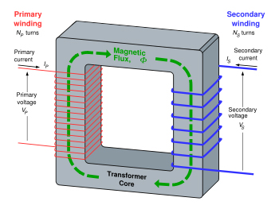

Slide 30
Questions:
1. List 3 ways the output of a motor and generator could be increased.(3/10)
motor | generator
More coils Stronger B Higher V, lower resistance Curved magnets Multiple windings | Faster rotation Stronger B Bigger armature Lower resistance More coils?

Slide 31
2. Describe and graph the current flowing in a solenoid as a magnet falls through it. (6/10)
Answer: There are competing forces here. The weight force and the repulsive force created by the induced current in the coil. If the magnet is heavy and the solenoid wide, there will be very little retardation of the magnet’s freefall.
The rate of change of flux is not uniform as B gets stronger as the magnet approaches (exponential) .
The velocity of the magnet is also increasing therefore the induced current changes more rapidly as the magnet leaves the coil.(07A11)

Slide 32
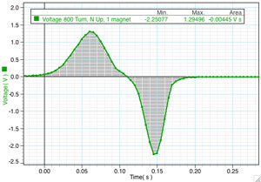

Slide 33
3. Graph the EMF in a generator (from 0⁰ to 360⁰) against the angle of rotation if 0⁰ is when the coil is parallel to the field. (7/10)
Answer: Think of the flux through the coil. Graph it. The rate of change of flux is the slope of the tangent to that curve at any given point. Where is it at a maximum and minimum?
Thought: the EMF induced is greatest when no flux is going through the coil.

Slide 34
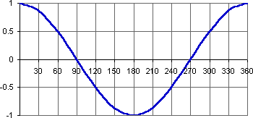

Slide 35
4. Graph the EMF induced in a metal bar rolling down an incline in a vertical mag field. (7.5/10)
Answer: This is different to question 2 about the falling magnet. Now only the velocity is changing. B remains constant.
The rate of change of magnetic flux is proportional to the velocity. This is increasing at a constant rate therefore the graph is a straight line.

Slide 36
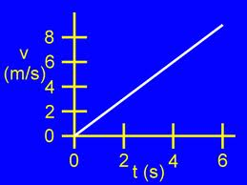

Slide 37
5. Calculate the current flowing in a coil made of copper of resistance 1.5x10⁻² ohm/m if the coil has 100 loops, has a diameter of 50mm and is being rotated in a mag field of 2.5mT at 50 Hz. (6/10 but lots of ways to lose marks)
Answer: V = IR. We need both V and R.
EMF = 100(2.5 x 10⁻³)(pi x 0.025²)
1/200
= 9.82 x 10⁻² V
R = 100 x 2pi x .025 x 1.5 x 10⁻² = 0.236ohms
I = V/R = 9.82 x 10⁻² / 0.236 = 0.42 A

Slide 38
What is the difference between Induced EMF, peak EMF, mean EMF and RMS EMF?
In an AC generator, we calculate the “EMF” induced. But the EMF is fluctuating like a sine curve, so what is the “EMF” of a generator? To calculate the Peak EMF, we use the formula:
EMF = 2πfNBA
where f = frequency of rotation.

Slide 39
To calculate the equivalent DC voltage, we calculate the RMS voltage (Root Mean Square) which is:
Peak EMF/√2 or Peak EMF x 0.707
To calculate the average or mean EMF (average would actually be 0 due to + and – values), we use:
Peak EMF x 0.637

Slide 40
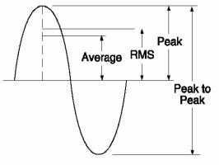

Slide 41
6. Draw the forces on a square coil in a motor when it is:
a. parallel to the field
b. perpendicular to the field
c. at 45º to the field. (9.5/10)
Answer: why is this rated so high? Because of c.
http://www.youtube.com/watch?v=IosJv9zarUw

Slide 42
Stability
http://www.youtube.com/watch?v=uKeENdyIluI
Standard definitions of stability refer to low centre of mass and width of base. As a general rule, it is true that the lower the COM and the wider the base, the more stable a body is. But is this always the case? Imagine two identical cans, one empty, one full. Which one is more stable? Now consider an empty wine glass and a full one. Which is more stable?
Stability is determined by how much energy is required to get the COM outside the base or raise it to its apex.
In general, a body is stable whilst the COM is providing a restoring moment.
There are 3 types of equilibrium:
a. Stable: any sideways force raises the COM
b. Unstable: any sideways force lowers the COM
c. Neutral: any sideways force neither lowers or raises the COM.
(eg. Describe the letters of CLASSROOM in terms of equilibrium)

Slide 43
Structures
1. There is very little theory in this topic. It is all about applying the concepts to various situations.
2. Essentially, a body is in equilibrium when:
a. The sum of the vertical forces = 0
b. The sum of the horizontal forces = 0
c. The sum of the clockwise moments = the sum of the anticlockwise moments where a moment is defined as a force multiplied by the perpendicular distance of the line of action of that force to a pivot. The choice of where to place the pivot is usually made to eliminate as many forces as possible from the calculations. But theoretically, moments could be taken about any point and their sum should still be zero. (2007 A2, A3)

Slide 44
Situations
http://www.saburchill.com/physics/chapters/0018.html
Balance beams(2006 B3)
Two pivots (two reaction forces)
Two string problems(book Q7)
Drawbridge(WACE2010Q19)
Ladders
Doors

Slide 45
Points to remember
Net reaction forces have magnitude and direction.
The unit of torque is Nm not Nm⁻¹ or N.
All the mass of an object acts through its COM.
If you are asked to describe the effect of changing one variable on another, use a mathematical relationship to justify your answer. Don’t state absolutes without justification.
The normal force acts against the weight force. It is only the reaction force when mg acts perpendicular to the surface.
Using components of tension rather than the full force is dangerous. 85% of all TEE papers I have marked who do it this way get the wrong answer.
Don’t assume a negative answer is incorrect. If just means the force is acting in the opposite direction to that which you assumed it would.
Vector triangles are fraught with danger. Only use them if you are 100% confident.

Slide 46
Questions.
Where should a 60kg child sit on a 5.0m seesaw to balance her 2x35kg friends sitting on the other side 0.5m from the pivot and 0.5m from the end? (careful! 5/10)
Always draw a diagram if one is not supplied. It will help you with the distances. The problem is distance from the ends compared to distances from the pivot.

Slide 47
2. A 50kg sign hangs from the end of a 3.0m awning. The 4.2m metal tie is attached 0.5m from the street end of the 200kg awning. Calculate the tension in the tie. (6.5/10)
Answer: Moments. Take your pivot where the awning meets the wall. This eliminates the reaction force of the wall on the awning. To be safe, use full moments, not components. Many mistakes are made doing it this way. The main one is students forget they have only calculated the vertical component and do not convert to the whole.
Answer = 2205N

Slide 48
3. Where should a 20kg mass be placed on a 4.0m 25kg trestle table to share the downward forces equally on the two supports one at one end and the other 1.0m from the other end? (8/10)
Answer: Why an 8? Because there are so many unknowns and your answers may confuse. You have to assume a distance and a moment. How do you express your answer?

Slide 49
4. What is the net reaction force of the ground on a 20kg, 5.0m ladder if it is supporting an 85kg man 2/3 of the way up it at an angle of 70º to the ground against a smooth wall? (9/10)
Answer: Lots of maths. The reaction force of the ground on the ladder not only has to support the weight force, but stop it from slipping (friction). These two forces have to be added vectorially.

Slide 50
5. How does this reaction force change as the ladder is placed more and more vertically against the wall? (8/10)
Answer: Use your expression from Q 4. Examine the relationship between the two variables listed in the equation. Isolate one and draw conclusions.

Slide 51
6. Can a string ever be perfectly horizontal? Justify your answer.
(9/10)
Answer: No. 2 reasons. The sum of the vertical forces must equal zero. What is counteracting the weight force? There must be a component of the tension doing this.
The second reason is mathematical:
2TsinA = mg ie T = mg/2sinA as A approaches 0⁰, sinA approaches 0. T approaches infinity.

Slide 52
Atomic Physics
When electrons slow down or drop to lower energy levels they lose energy. This energy is given off as electromagnetic radiation or photons.OH1
The wavelength and frequency of the photon emitted is determined by the amount of energy lost according to the formula:
E = hf
where h = planck’s constant or 6.63 x 10⁻³⁴Js
Electrons held around nuclei are found in distinct energy levels or quanta. They are not found between levels.
Each element has its own distinct combination of levels and energy required to ionise an electron.
When an atom of a given element is excited, electrons jump to higher levels and other electrons fall back down to take their place.
Some of the wavelengths of this EMR fall into the visible range and when separated by a spectrometer, they appear as a combination of coloured lines called an emission spectrum.
http://www.pollutionissues.com/images/paz_02_img0208.jpg

Slide 53
7. This spectrum is like a fingerprint for that element. This can be used to identify components of an unknown in spectral analysis. (Universe expanding?) (spectra diagram)
8. If white light is shone through a gas, the gas will absorb those wavelengths which correspond to the energy differences between its levels. This is an absorption spectrum and appears as a rainbow with black lines.
9. A heated gaseous compound will emit band spectrum and a heated solid will emit a continuous spectrum (incandescence).OH3
10. Some substances can absorb photons outside the visible range and re-emit them as visible light. This is called fluorescence. Short wavelength, high frequency ultra violet light is usually absorbed in one big jump and the emitted visible light is produced as electrons fall back down in series of smaller jumps.(file)
11. Some substances can hold electrons in higher energy levels for some time and slowly release them. This is called phosphorescence. These substances glow in the dark and are described as being in a metastable state.
12. Some metals can be ionised by sunlight. This is called the photoelectric effect where the energy of the emitted electrons equals the energy of the incoming photon minus the work function of the metal.

Slide 54
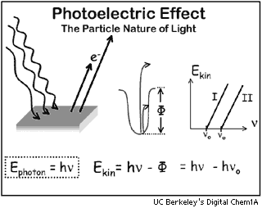

Slide 55
The photoelectric effect is an example of a photon, or light, acting as a particle. An individual photon can ‘collide’ with an individual electron and donate all its energy.
Light also behaves like a wave when it diffracts, refracts and undergoes interference.
This is called the dual nature of light. OH2
http://phet.colorado.edu/en/simulation/photoelectric
www.youtube.com/watch?v=V94shlqPlSI

Slide 56
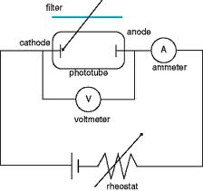

Slide 57
4
4. Using examples, explain the dual nature of light.
http://www.itp.uni-hannover.de/~zawischa/ITP/diffraction.html
http://phet.colorado.edu/en/simulation/photoelectric

Slide 58
X-rays
X-rays are high energy, high frequency, short wavelength photons. They easily penetrate low density materials and expose light sensitive materials to produce images of high density substances like bones. They are not good for producing images of soft tissue.
They are produced when an anode produces electrons which are then accelerated across a potential difference and fired at a metal cathode. (Tungsten, Molybdenum)
http://www.youtube.com/watch?v=IRBKN4h7u80&NR=1
The electrons are decelerated by the cathode in one or several collisions. Because the electrons have high energy, the photons given off are in the x-ray range.
The metal target also gives off x-rays as electrons fall down to replace ionised electrons. (Review Bremsstrahlung radiation)

Slide 59
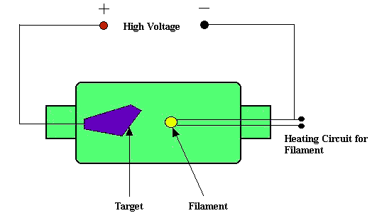

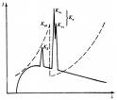

Slide 60
Calculations
Emission spectrum. The energy levels of an atom will be given. These will be expressed as the energy required to ionise electrons from that level. It is strongly recommended you change these to positive values before performing calculations.
If an atom has n energy levels or an electron cascades from the n^{th} energy, the number of possible spectral lines is given by:
^{n}C₂
eg. 7 levels = 7x6/2 = 21 lines
3. If an atom is bombarded by electrons, the incoming electrons can donate some of their energy to promote an electron from the ground state and bounce off with the remaining energy.
.

Slide 61
4. If an atom is bombarded with photons, only those photons with the exact energy corresponding to the energy difference between two levels can be absorbed. In this case they lose all their energy.
5. There is an inverse relationship between wavelength and energy drop.
6. Make sure you show the direction of the electron transition on any level diagrams.
(WACE2010Q14)

Slide 62
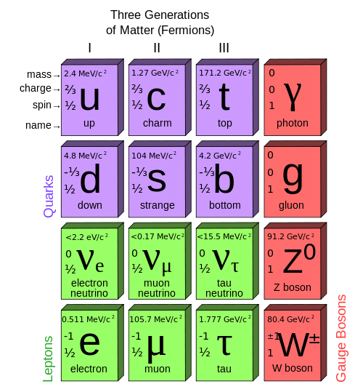
Sub Atomic Particles (StandardModel)

Slide 63
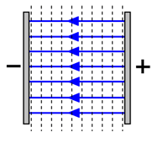
Electrodynamics
The strength of an electric field between two parallel plates can be described two ways:
E = F/q or E = V/m

Slide 64
A charged particle in an EF will experience a force equal to Eq so ma = Eq.
We can ignore gravity if mg is much smaller than Eq.
If not, add mg vectorially to the calculation.
An electric field is a vector quantity with the direction defined by the force experienced by a positive point charge. (2011 Q1, 15)

Slide 65
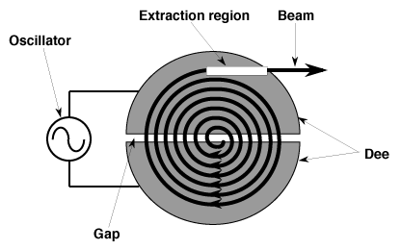
Cyclotron
A cyclotron is a type of particle accelerator in which charged particles accelerate outwards from the center along a spiral path. The particles are held to a spiral trajectory by a static magnetic field and accelerated by a rapidly varying (radio frequency) electric field.

Slide 66
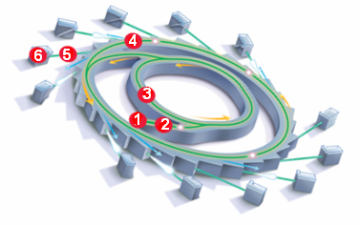
Synchotron
A synchrotron is a particular type of cyclic particle accelerator originating from the cyclotron in which the guiding magnetic field (bending the particles into a closed path) is time-dependent, being synchronized to a particle beam of increasing kinetic energy. The synchrotron is one of the first accelerator concepts that enable the construction of large-scale facilities, since bending, beam focusing and acceleration can be separated into different components.

Slide 67
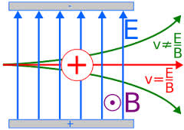
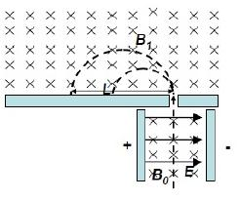
Velocity selector
A velocity selector is used in accelerator mass spectrometry to select particles based on their speed. The velocity selector is composed of orthogonal electric and magnetic fields, such that particles with the correct charge to mass ratio and speed will be unaffected, and other particles will be deflected.
A mass spectrometer consists of three components: an ion source, a mass analyzer, and a detector.
r = mv/Bq and v = √2qV/m
So r = 1/B √2mV/q

Slide 68
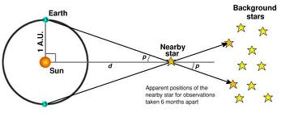
Parallax Method.
1 arc sec = 1/3600 degrees.
If parallax angle = 1 arc sec, d = 1 parsec = 3.26 light years.

Slide 69
Special relativity
This is a huge topic covered by 1 objective in the syllabus. It is hard to know what depth to go into.
The basis of Einstein’s theory consists of 2 main postulates:
There is no preferred inertial frame. If you feel at rest then you are at rest as much as anyone can be.
The speed of light in a vacuum is measured to give the same value, c, by any observer.
dummies

Slide 70
These translate into the fact that different observers observe different events depending on their inertial frame of reference. The crucial aspect to appreciate is the speed of light remains constant. (PPT)(WACE2010Q9)
Travelling close to the speed of light creates some changes to the classic Newtonian version of Physics.
To calculate these changes requires a Lorentz factor equation. These are not in the syllabus but most of the sample problems introduce them and then ask students to use them.
  Time dilation
  Length contraction
  Relativistic mass
  http://www.phys.vt.edu/~takeuchi/relativity/practice/

Slide 71
The End.
All the best for your exams.
Your lives are about to change forever.

